Slide 1
Lab 7 Solution&Hint
by wwy
add solution by zy

Slide 2
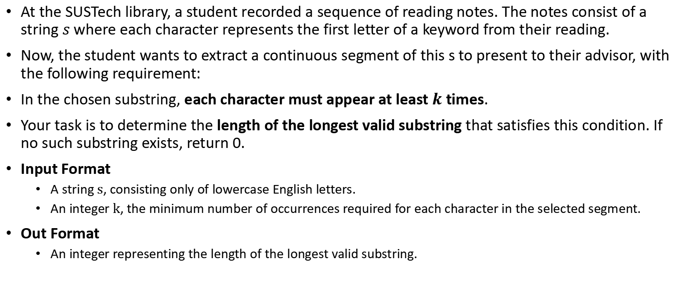
Lab 7A
At the SUSTech library, a student recorded a sequence of reading notes. The notes consist of a string $s$ where each character represents the first letter of a keyword from their reading.
Now, the student wants to extract a continuous segment of this s to present to their advisor, with the following requirement:
In the chosen substring, each character must appear at least $k$ times.
Your task is to determine the length of the longest valid substring that satisfies this condition. If no such substring exists, return 0.
Input Format
A string $s$, consisting only of lowercase English letters.
An integer $k$, the minimum number of occurrences required for each character in the selected segment.
Out Format
An integer representing the length of the longest valid substring.

Slide 3
Lab 7A sample1
Input: ddbbb 3
Output: 3
Explanation: The substring "bbb" is valid since 'b' appears 3 times.

Slide 4
Lab 7A sample2
Input: acabbab 2
Output: 5
Explanation: The substring "abbab" is valid since 'a' appears 2 times and 'b' appears 3 times.

Slide 5
Lab7A Solution
Input: ababacbdeff 2
character | appear times
a | 3
b | 3
c | 1
d | 1
e | 1
f | 2
We can observe:
These characters that appear times < k cannot be part of any valid substring, so they can act as "splitters"

Slide 6
Lab7A Solution
For each invalid character, split the string into parts where the invalid character is excluded. Recurse on each split part.
ababacbdeff
ababa
b
“”
ff
character | appear times
f | 2
character | appear times
a | 3
b | 2
length<k,return 0
length<k,return 0
no split character,return 2
no split character,return 5
Max Length = 5

Slide 7
Lab 7B
You are given a list of rectangles on a 2D plane. Each rectangle is represented by a triplet [left_i, right_i, height_i], where:
left_i is the x-coordinate of the left edge of the rectangle,
right_i is the x-coordinate of the right edge (exclusive),
height_i is the height of the rectangle.
Each rectangle extends vertically from height 0 up to height_i, and spans horizontally from left_i to right_i.
All rectangles have a width along the x-axis and are aligned with the axes.
Your task is to compute the outline of the combined shape formed by these rectangles, as seen from the front (along the y-axis).
This outline can be represented by a list of key points which indicate where the height of the shape changes.

Slide 8
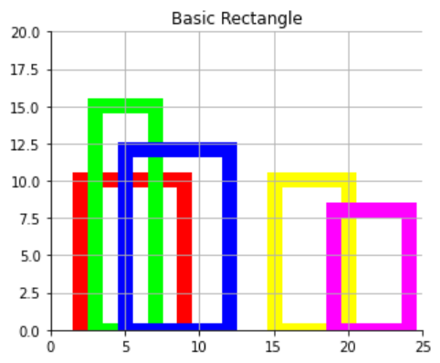
Lab 7B sample
5
2 9 10
3 7 15
5 12 12
15 20 10
19 24 8
Input
Output
2 10
3 15
7 12
12 0
15 10
20 8
24 0

Slide 9
Lab 7B
Input Format
n: the number of the rectangles
An array rectangles of shape n x 3, including left_i, right_i, height_i.
Output Format
A list of key points x1 y1, x2 y2, ..., sorted in increasing order of x.
Each key point represents a horizontal position x where the height changes to y.
Consecutive key points must not have the same height value.
The final point should represent the drop to ground level (`height = 0`) at the end of the last rectangle.

Slide 10
Lab7B Solution
Try to divide the problem:

Slide 11
One rectangle
2 9 10
3 7 15
(3,15)
outline:
(2 10)(9 0)
outline:
(3 15)(7 0)
(2,10)
(9,0)
(7,0)

Slide 12
How to conquer?
2 9 10
3 7 15
(2 10)(9 0)
(3 15)(7 0)
(3,15)
(2 10)(3 15)(7 10)(9 0)
(2,10)
(7,10)
?
(9,0)

Slide 13
How to conquer?
LSet
RSet
(3,15)
(2 10)(9 0)
(3 15)(7 0)
i
j
(2,10)
Left Pre Hight = 0
Right Pre Hight = 0
MSet <--
∅
(9,0)
(7,0)
1. LSet[0].x < RSet[0].x, and
LSet[0].y > Right Pre Hight
MSet：
(2 10)
Left Pre Hight = 10
i <-- i+1

Slide 14
How to conquer?
LSet
RSet
(3,15)
(2 10)(9 0)
(3 15)(7 0)
i
j
(2,10)
Left Pre Hight = 10
Right Pre Hight = 0
MSet：
(2 10)
(9,0)
(7,0)
2. LSet[1].x > RSet[0].x,
RSet[0].y > Left Pre Hight
MSet：
(2 10) | (3 15)
Right Pre Hight = 15
j <-- j+1

Slide 15
How to conquer?
Right Pre Hight
LSet
RSet
(3,15)
(2 10)(9 0)
(3 15)(7 0)
i
j
(2,10)
Left Pre Hight
Left Pre Hight = 10
Right Pre Hight = 15
MSet：
(2 10) | (3 15)
(9,0)
(7,0)
3. LSet[1].x > RSet[1].x
RSet[1].y < Left Pre Hight and
Right Pre Hight > Left Pre Hight
RSet[1].y
MSet：
(2 10) | (3 15) | (7 10)
Right Current Hight = 0
j <-- j+1 j > RSet.size stop

Slide 16
How to conquer?
(3,15)
LSet
RSet
(2 10)(9 0)
(3 15)(7 0)
(2,10)
i
j
Left Pre Hight = 10
Right Pre Hight = 0
(9,0)
(7,0)
MSet：
(2 10) | (3 15)
(3,15)
4. Append the remaning in LSet to MSet
(2,10)
(7,10)
MSet：
(2 10) | (3 15) | (7 10) | (9,0)
(9,0)

Slide 17

More cases
LSet[i].x > RSet[j].x
RSet[i].y <= Left Pre Hight and
Right Pre Hight <= Left Pre Hight
LSet[i].x < RSet[j].x
LSet[i].y <= Right Pre Hight and
Left Pre Hight <= Right Pre Hight
LSet[i].x = RSet[j].x
...
...

Slide 18
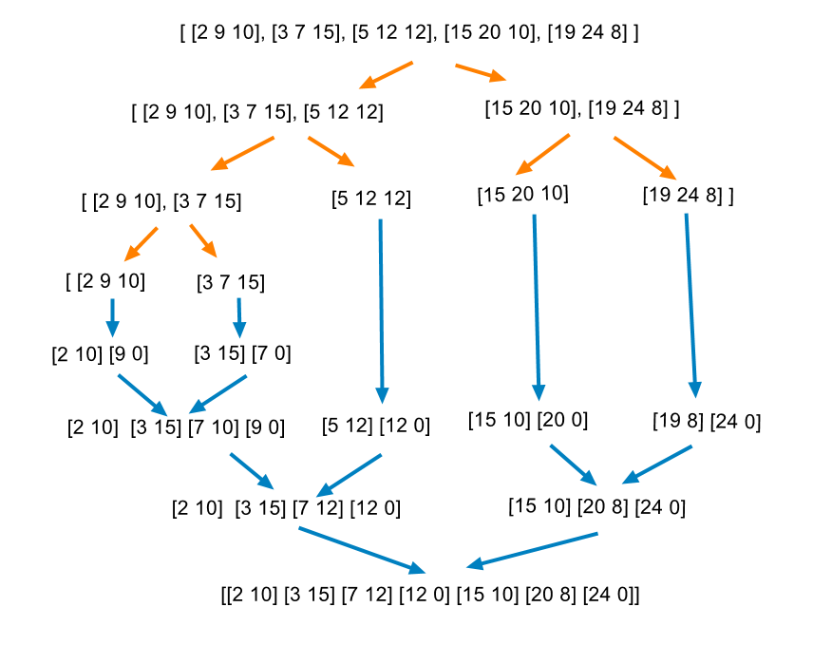
Divide And Conquer

Slide 19
THX:-)

